Slide 1
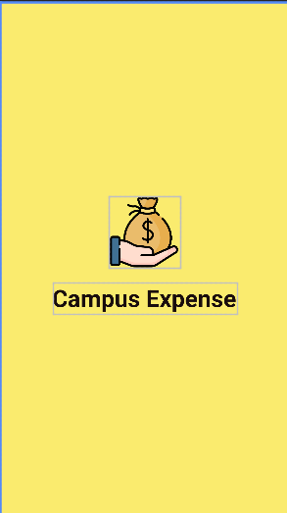


Group 5
ASM 2 - APPLOCATION DEVELOPMENT
Welcome
Campus Expense
IT0601

Slide 2
Shawn Garcia
STUDIO SHODWE
Founder and CEO
www.reallygreatsite.com
Disclaimer
The information contained in this document is confidential, privileged, and only for the information of the intended recipient and may not be used, published, or redistributed without the prior written consent of Studio Shodwe.
NEXT

Slide 3
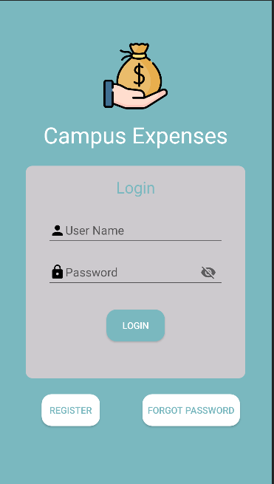
Login Activity
When start Campus Expenses app, it will return Login activity, require user input username and password.
If user enter valid username and password, it will allow user to enter the main menu, if not, it displays error and required user to input again.
If user don’t have any account to login, they can press register button to go to register activity and create new account
If user forgot their password or username, they can press forgot password button to go to restore activity to get their account back

Slide 4
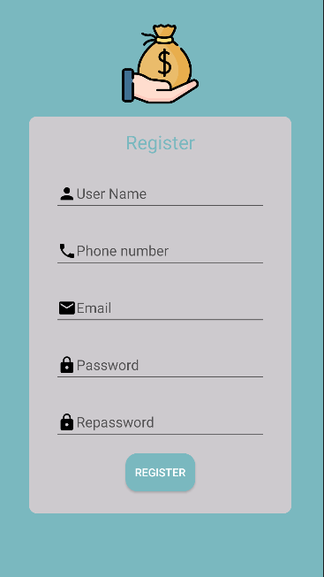
Register Activity
When press register, it will validate the phone number, email, password and repassword and compare it to the database to find if the username is exitst or not. If it exist it will allow to add new account, send succesfully created new account notification and return back to the login activity.
To register a new account user will have to input the required input and press register.

Slide 5
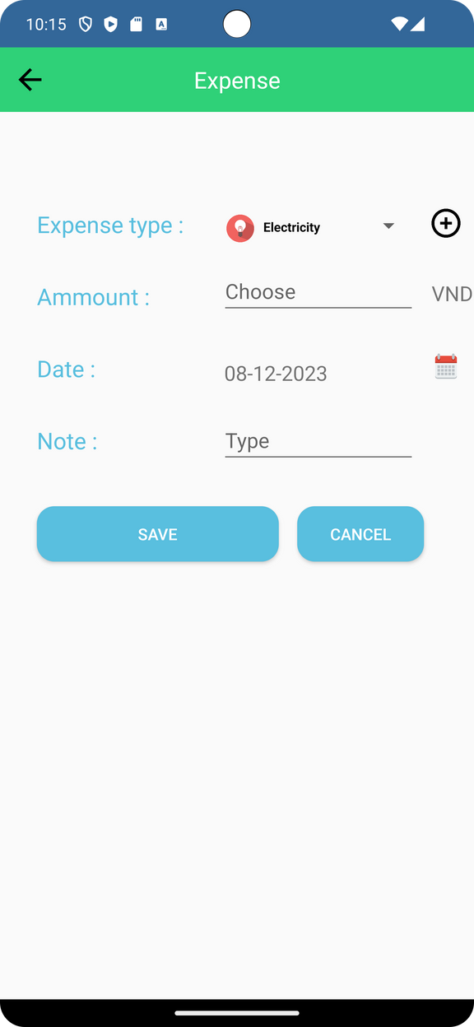
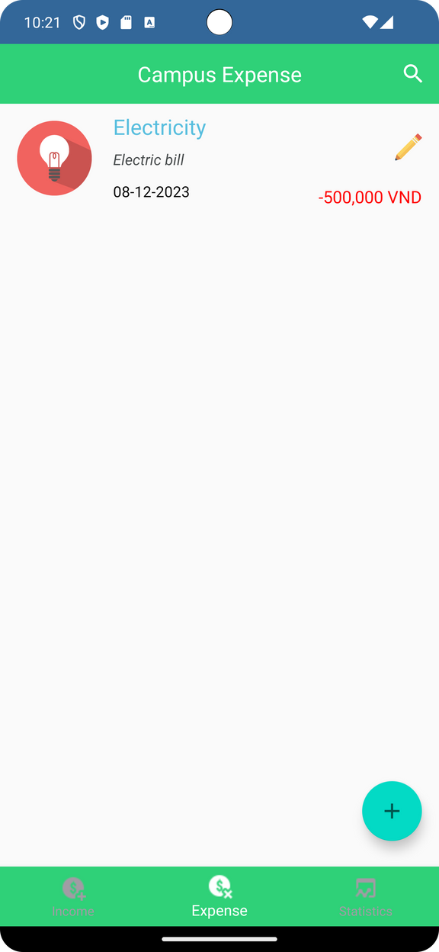
Add expense activity
When press add expense, the app nagivate user to the Add Expense tab. User need to choose expense type, enter money amount, enter date and Note(To be more specific about that expense).
After that, User can press save to save the expense.
After press save button, the application will navigate user to the main activity, which will show every expense have been created

Slide 6
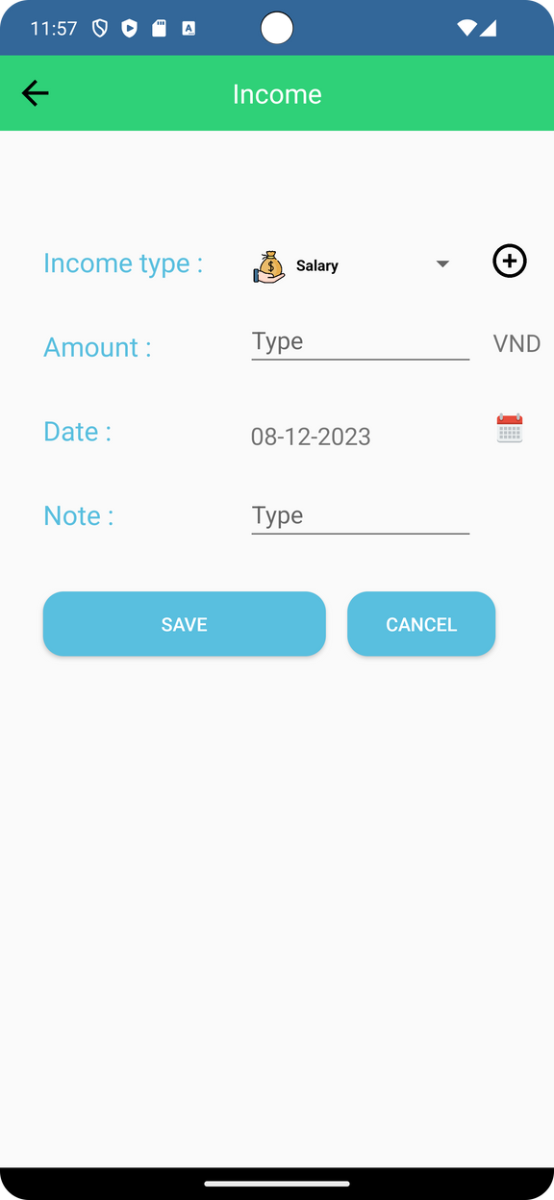
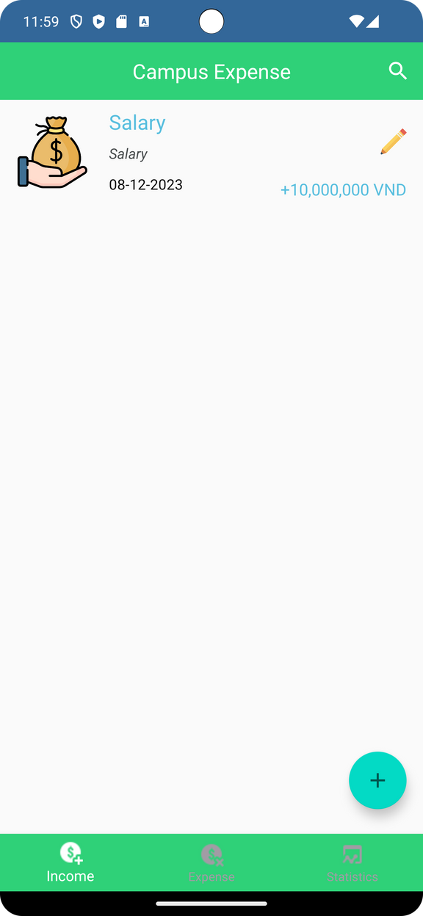
Add income activity
The subsequent step involves pressing 'Save' to store the income record, paralleling the workflow in the 'Add Expense' activity.
Similarly to the 'Add Expense' activity, when users initiate the 'Add Income' process, the app guides them to the 'Add Income' tab. Much like adding an expense, users are prompted to choose the income type, enter the amount, specify the date, and provide additional notes for detailed context.

Slide 7

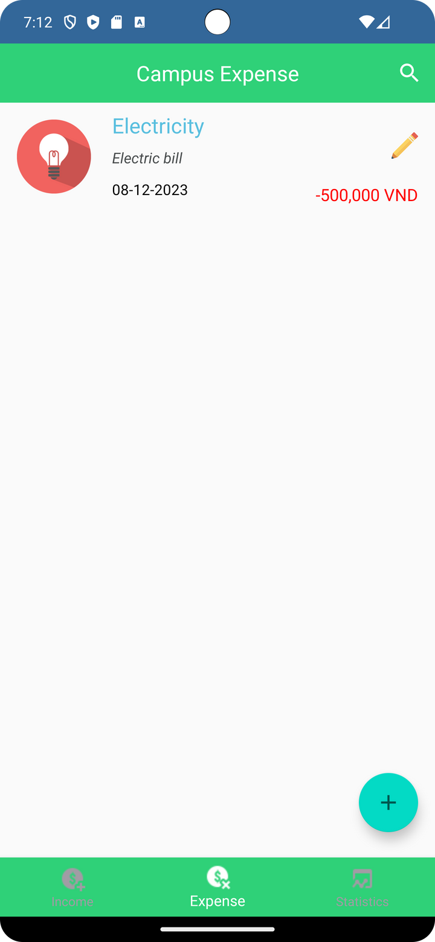

Edit Activity
To edit an expense/income check, user will have press into the pencil icon next to the expense/income you need to edit

Slide 8
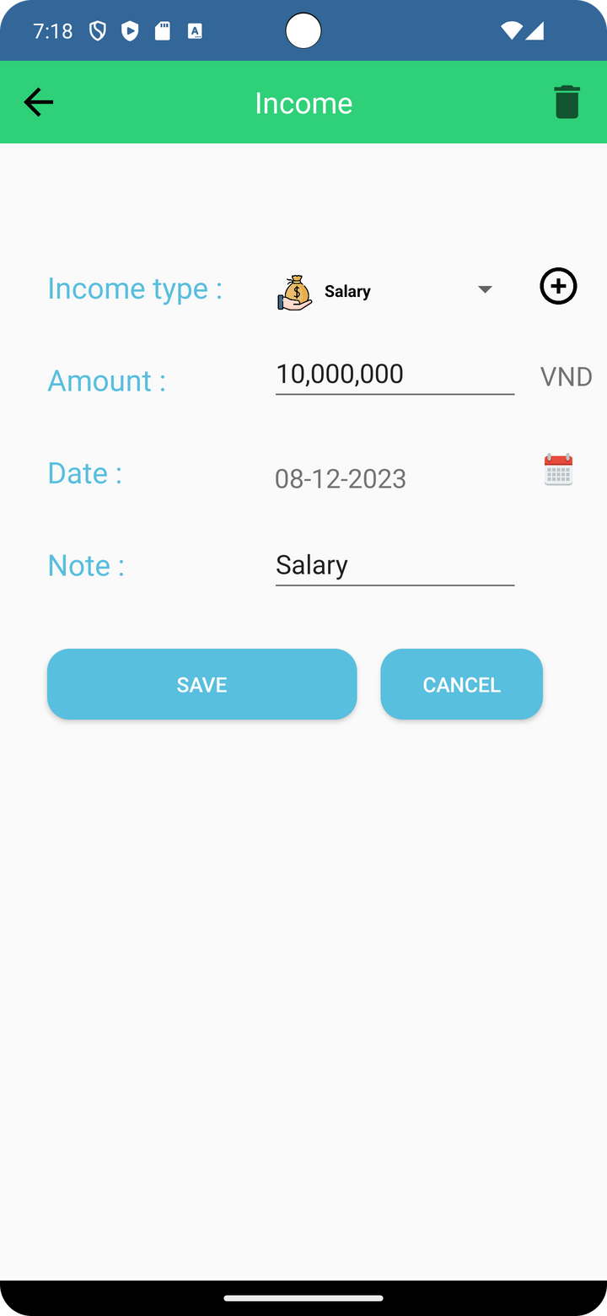
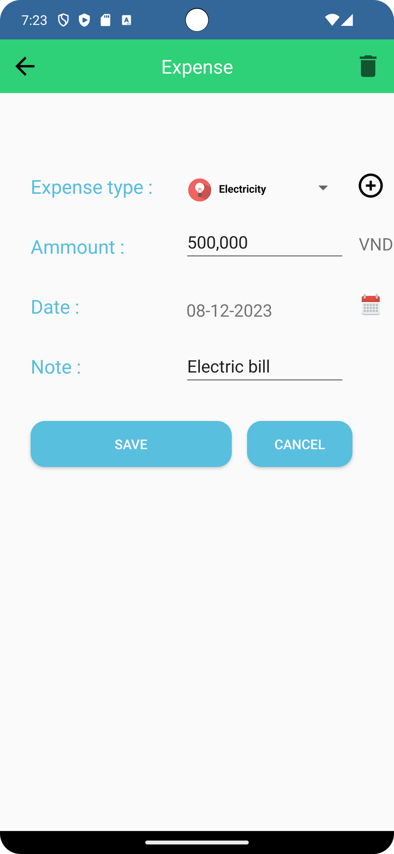
Edit Activity
After clicked into the pencil icon, the application will show the edit activity(which apparently look similar to the Add income/expense activity.
After done update the income/expense, user need to press save button. After that, the information will be updated

Slide 9


Delete activity
After delete, the application will navigate user to the mainpage, which will show that expense/income have been deleted
To delete an existed income/expense, user need to click onto the pencil icon next to the income/expense they want, after that, click into the recycle bin button to delete

Slide 10
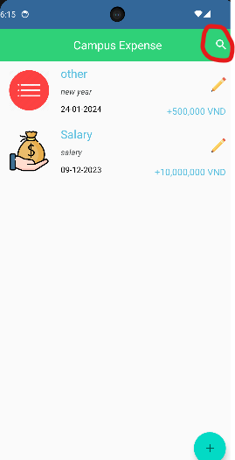
Search Activity
When the user want to search for a specific Income or expense, the user just simply click on the search icon indicate by a red circle
after the user click the search icon the app will redirect the user to the search activity which will include income search activity and expense search activity

Slide 11
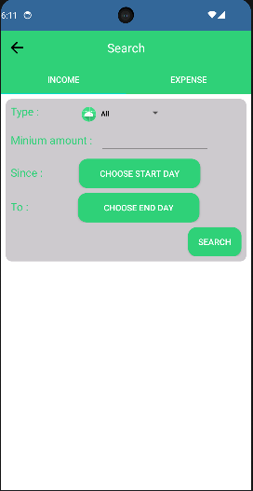
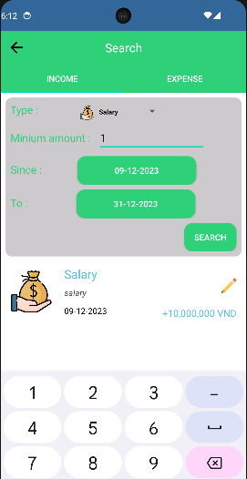
Income Search Activity
the user option range from what type of income, minimum amount , when they start adding the income and which date they want to end it. if all the data that user put in match with the data that exits in the database, the app will display that data bellow the search button and if the data doesn’t match with each other the will not display anything on the screen
when the user is in this activity ,the user can freely choose from the all the option present to them to find their specific income they have made.

Slide 12
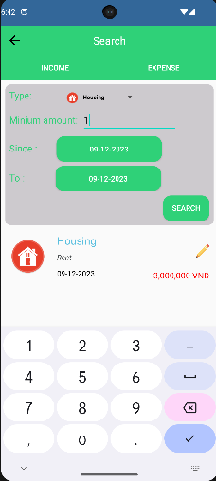
Expense Search Activity
the user option range from what type of expense, minimum amount , when they start adding the expense and which date it will expired. if all the data that user put in match with the data that exits in the database, the app will display that data bellow the search button and if the data doesn’t match with each other the will not display anything on the screen
when the user is in this activity ,the user can freely choose from the all the option present to them to find their specific expense they have made.

Slide 13
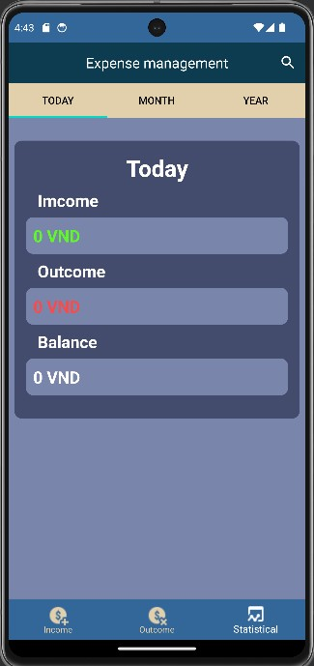
EXPENSE APP DEMO
Statistical
Function
Group 5 - IT0601
BH00317-TranCongHoang

Slide 14
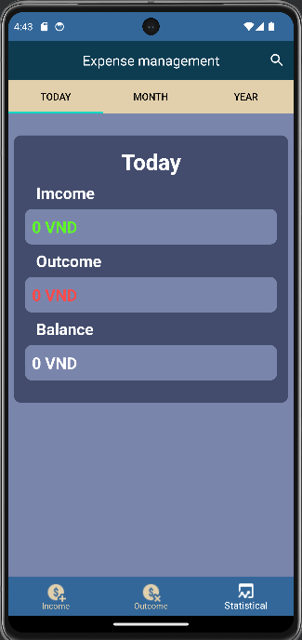
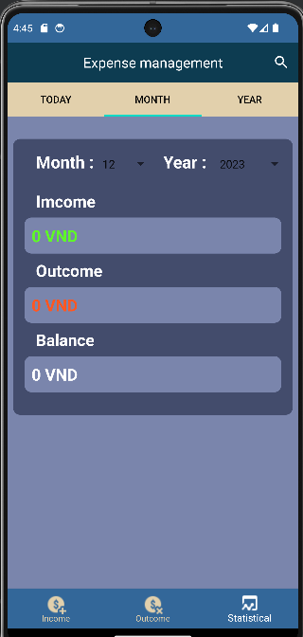
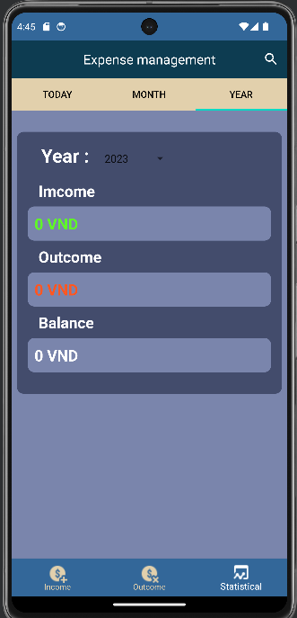
Group 5 - IT0601
BH00317-TranCongHoang

Slide 15
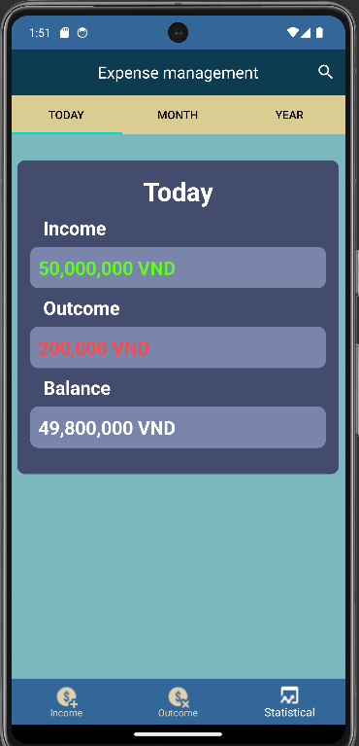



FUNCTION
Daily Statistics
Green
Statistics on total income for the day
Statistics of all spending for the day according to each item income, outcome and finally calculate the remaining balance for the day.
Red
Statistics of total outcomes for the day
Balance = Income - Outcome
Income
Outcome
Balance
White
Remaining balance for the day
100%
30%
70%
Group 5 - IT0601
BH00317-TranCongHoang

Slide 16
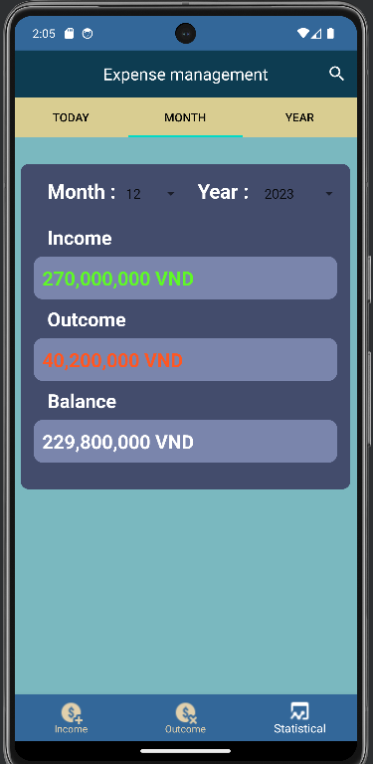



FUNCTION
Month Statistics
Green
Statistics on total income for the day
Statistics on all expenses for each month of the year according to each income and outcome category and finally calculate the remaining balance of the month.
Red
Statistics of total outcomes for the day
Balance = Income - Outcome
White
Remaining balance for the day
Income
Outcome
Balance
100%
60%
40%
Group 5 - IT0601
BH00317-TranCongHoang

Slide 17
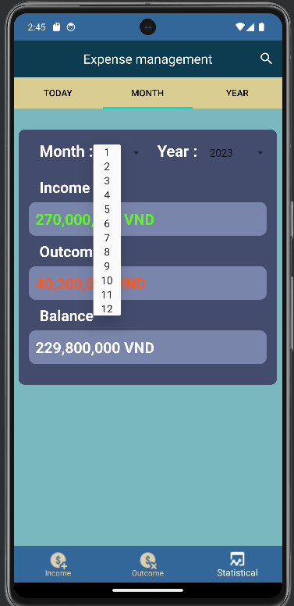
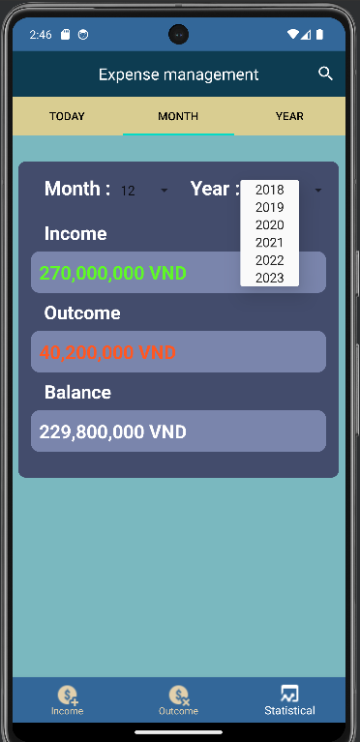
FUNCTION
Month Statistics
Helps users have an overview of their income, spending and account balance in each month throughout the year.
Users can create detailed expense reports and statistical charts to better understand their income, expenses and financial allocation.
This function allows users to monitor and manage personal financial situation easily and conveniently.
Helps people have reliable control over their personal finances.
Group 5 - IT0601
BH00317-TranCongHoang

Slide 18
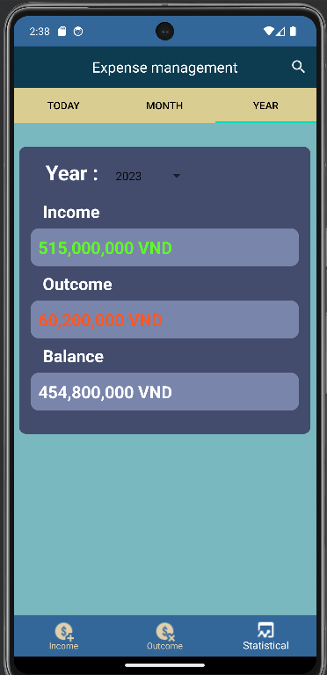



FUNCTION
Year Statistics
Green
Statistics on total income for the year
Statistics on all yearly expenditures by each income and outcome item and finally calculate the remaining balance of the year.
Red
Statistics of total outcomes for the year
Balance = Income - Outcome
Engagement
Purchases
Purchases
White
Remaining balance for the year
100%
80%
20%
Group 5 - IT0601
BH00317-TranCongHoang

Slide 19
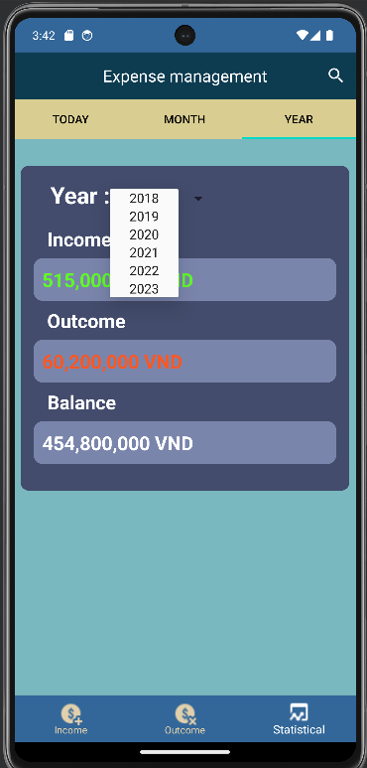
FUNCTION
Years Statictisc
Helps users have an overview of their income, spending and account balance in each month throughout the year.
Users can create detailed expense reports and statistical charts to better understand their income, expenses and financial allocation.
This function allows users to monitor and manage personal financial situation easily and conveniently.
Helps people have reliable control over their personal finances.
Group 5 - IT0601
BH00317-TranCongHoang

Slide 20
Group 5
ASM 2 - APPLOCATION DEVELOPMENT
Thank You
www.reallygreatsite.com
hello@reallygreatsite.com
123-456-7890

